Slide 1


Assembly
The language that talks directly to the CPU
Makar Korjenevskiq
Group: 594-2

Slide 2

Glossary
Processor / CPU
Central Processing Unit — the "brain" of the computer.
Low-level language
A language close to machine code, with minimal abstractions.
High-level language
A language with abstractions (Python, Java, C++), far from the processor.
Instruction
A single command to the CPU (e.g., MOV, ADD, JMP).
Register
An extremely fast memory cell inside the processor.
Machine code
A set of zeros and ones that the CPU executes directly.
Microcontroller
A small computer on a single chip (in watches, remotes, sensors).

Slide 3


Assembly Language: Current Status
Definition: Low-level programming language.
Direct hardware manipulation capabilities.
Critical for embedded systems today.

Slide 4

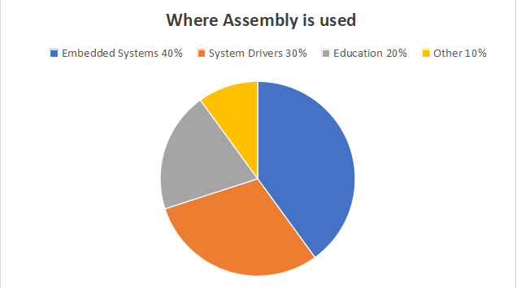
Usage Statistics & Demographics
Primary sector: Embedded systems engineering.
Secondary sector: Operating system kernels.
15% of developers use it regularly.
Data from global developer surveys.

Slide 5

Assembly Language: Current Status
Assembly used by 5.4% of developers.
Ranked below C, Rust, Go.
Higher than Ruby, Dart, Lua.

Slide 6
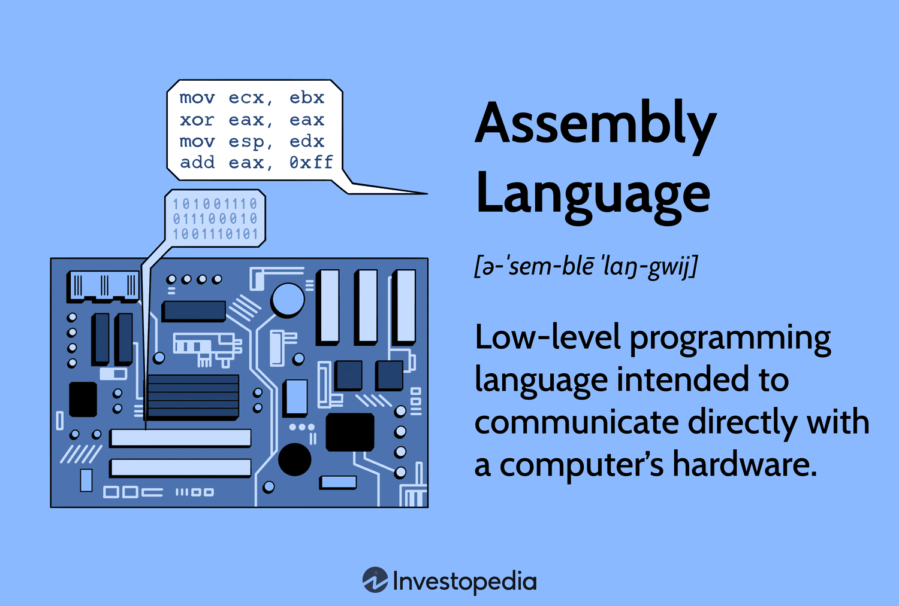
yjhttps://www.google.com/imgres?q=What%20is%20Assembly%3F&imgurl=https%3A%2F%2Fwww.investopedia.com%2Fthmb%2FiQF7e3NvVbuc4CQMaFS-ieWX4Nw%3D%2F1500x0%2Ffilters%3Ano_upscale()%3Amax_bytes(150000)%3Astrip_icc()%2Fassembly-language.asp-final-664011aa8a8d4774ab6538e594961475.png&imgrefurl=https%3A%2F%2Fwww.investopedia.com%2Fterms%2Fa%2Fassembly-language.asp&docid=zHUZuOfMRSt2KM&tbnid=eAOfxHIEHQyJzM&vet=12ahUKEwi46v6U_9yTAxWjFVkFHcxUK9IQnPAOegQIHBAB..i&w=1500&h=1013&hcb=2&ved=2ahUKEwi46v6U_9yTAxWjFVkFHcxUK9IQnPAOegQIHBAB
What is Assembly?
Low-level programming language
One instruction = one CPU operation
Full control over memory and registers

Slide 7
Key Advantages
Maximum execution speed
Minimal program size
Perfect for devices with very small memory
(watches, remote controls, sensors)
Page 4

Slide 8

Key Disadvantages
Very hard to learn and use
Slow development (brick by brick)
Code for one CPU does not work on another
Expensive to maintain
Page 5

Slide 9
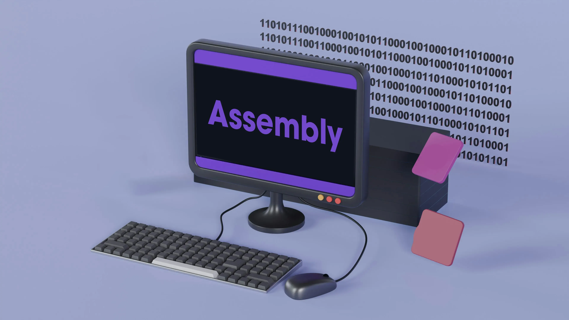
Where is Assembly used?
Device drivers, Microcontrollers and embedded systems, Operating system bootloaders, Cryptography, Game emulators and retro consoles
Page 6

Slide 10

Conclusion
Assembly is a powerful tool for experts. It is used where speed and size matter most. Knowing Assembly means truly understanding how computers work.
Page 7

Slide 11




THANK YOU
Page 8

